Slide 1
Warm- up
a=
b=
c=
d=
e=
f=
g=
h=
Homework out for checking!!!
Notes:
a= 90
68
112
112
68
56
124
124

Slide 2
4.4, 4.5 Triangle Congruency Shortcuts
Learning Intentions:
Explore shortcut methods for determining whether triangles are congruent.
Practice construction skills.
Success Criteria:
I can apply congruence shortcuts appropriately to prove triangles are congruent.

Slide 3
Investigation 1
Part 1
Step 1: Cut one of your spaghettis into three pieces measuring 4cm, 6cm and 9cm
Step 2: Can you make a triangle out of these pieces?
Part 2
Step 3: Cut your second spaghetti into three pieces measuring 10cm, 5cm and 4cm.
Step 4: Can you make a triangle?
***What is the difference between the measurements in the sides in both parts?

Slide 4
Reflection Questions
What is true about the measurements of the sides in the 1st part of the investigation?
What is true about the measurements of the sides in the 2nd part of the investigation that led you to conclude that you could not make a triangle?
Triangle Inequality Conjecture:
The sum of the lengths of any two sides of a triangle is __________________ the length of the third side

Slide 5
Practice
In 1-4, determine whether it is possible to draw a triangle with sides having the given measures.

Slide 6
Investigation 2- where are the largest and smallest angles?
Step 1- Draw two scalene triangles, one acute and one obtuse.
Step 2- Measure the angles in your triangles. Label the greatest measure <L, the angle with the second greatest measure <M, and the smallest angle S.
Step 3- Measure the three sides. Label the longest side l, the second longest side m, and the shortest side s.
Step 4- Which side is opposite <L? <M? <S?
Step 5- Write a conjecture about where the largest and smallest angles are in a triangle in relation to the longest and shortest sides.

Slide 7
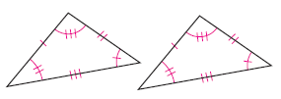
How do we know if two triangles are congruent?
In any triangle, there are three angles and three sides.
If two triangles are congruent, all three corresponding sides and all three corresponding angles must be congruent.
But to prove that two triangles are congruent, we do not need to show that all three angles and all three sides are congruent- so six parts in total. Instead we can prove two triangles are congruent by using only three parts.

Slide 8
How do we know if two triangles are congruent?
Today we will look for congruence shortcuts by comparing three parts of each triangle. We will investigate each case to decide if it proves that two triangles are congruent or not.

Slide 9
Group Work
* We will count from 1-6, making 6 different groups.
* Each group will investigate one of the possible shortcuts and share their findings with the class.
* If your group has to duplicate an angle, I will give you patty paper.
* You will need a blank sheet of paper, a compass and sharpened pencil

Slide 10
Break into groups
Each group will investigate one case- SSS, SAS, ASA, SAA, AAA, or SSA.
You will follow the investigation and decide if the shortcut works to show that two triangles are congruent.
You will then present your findings to the class.
You will need- a blank sheet of paper, a compass, and a sharpened pencil.

Slide 11
Group 1- SSS

Slide 12
Fill in your notes:
1. Triangle Congruence Shortcut: ___________________

Slide 13
Group 2 - SAS

Slide 14
Fill in your notes:
2. Triangle Congruence Shortcut: ___________________

Slide 15
Group 3- SSA

Slide 16
Group 4- ASA

Slide 17
Fill in your notes:
3. Triangle Congruence Shortcut: ___________________

Slide 18
Group 5- SAA

Slide 19
Fill in your notes:
4. Triangle Congruence Shortcut: ___________________

Slide 20
Group 6- AAA

Slide 21
Quick Fire Check for Understanding-
Number 1-6 on a separate sheet of paper.
There will be a triangle on each slide with different marks of congruency.
Tell whether the triangle is SSS, SAS, ASA, SAA or NEITHER.
Just write the conjecture- don’t draw the triangle-
Ready?

Slide 22
1. SSS, SAS, ASA, SAA, or Neither?

Slide 23
2. SSS, SAS, ASA, SAA, or Neither?

Slide 24
3. SSS, SAS, ASA, SAA, or Neither?

Slide 25
4. SSS, SAS, ASA, SAA, or Neither?

Slide 26
5. SSS, SAS, ASA, SAA, or Neither?

Slide 27
6. SSS, SAS, ASA, SAA, or Neither?

Slide 28
Answers! Did you get them right?
1- SSS
2- SAS
3- NEITHER
4- SAA
5- ASA
6- NEITHER

Slide 29
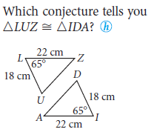
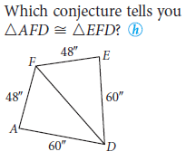
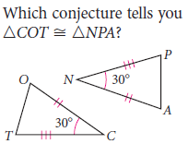
Lets Practice…SSS, SAS, ASA, SAA?
1. 2. 3.

Slide 30
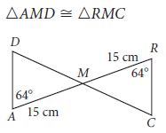
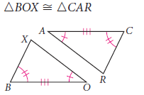
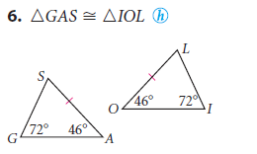
Lets Practice…SSS, SAS, ASA, SAA?
4. 5.

Slide 31
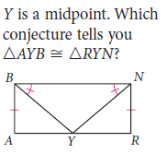
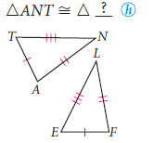
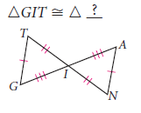
Lets Practice…SSS, SAS, ASA, SAA?
For examples 8 and 9 tell which triangle is congruent to the first one listed.
7. 8. 9.

Slide 32
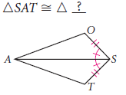
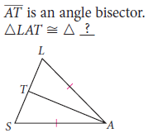
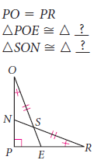
Lets Practice…SSS, SAS, ASA, SAA?
For examples 10, 11, and 12 tell which triangle is congruent to the first one listed.
10. 11. 12.

Slide 33
Exit Ticket
Take out a spare sheet of paper- rip it in half and give half to a partner.
Write your name on top
Number 1-5
REMEMBER!- no notes and no talking!
Just write the letter of the correct answer.

Slide 34
Choose the best answer.
1. Give the conjecture that proves the two triangles are congruent.
A. SSS
B. SAS
C. ASA
D. SAA

Slide 35
Choose the best answer.
2. Give the conjecture that proves the two triangles are congruent.
A. SSS
B. SAS
C. ASA
D. SAA

Slide 36
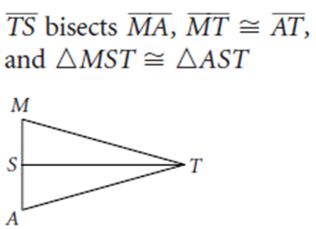
Choose the best answer.
3. Give the conjecture that proves the two triangles are congruent.
A. SSS
B. SAS
C. ASA
D. SAA

Slide 37
Choose the best answer.
4. Give the triangle that is congruent to ∆ ANT and the conjecture that proves the two triangles are congruent.
A. ∆ELF, by SSS.
B. ∆FLE, by SSS.
C. ∆ FEL, by ASA.
D. Cannot be Determined.

Slide 38
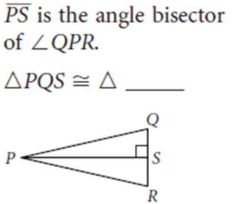
Choose the best answer.
5. Give the triangle that is congruent to ∆ PQS and the conjecture that proves the two triangles are congruent.
A. ∆PQR, by SSS.
B. ∆ SRP, by AAA.
C. ∆ PRS, by ASA.
D. Cannot be Determined.

