Slide 1
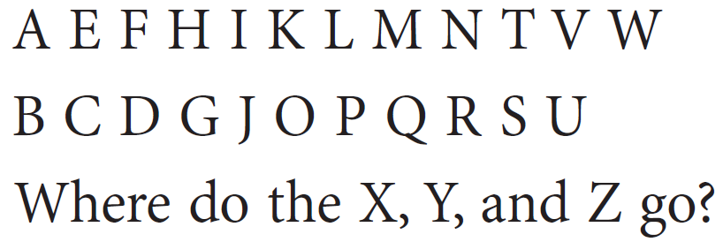
Warm-up: Use inductive reasoning to draw the next shape.
Notes:
ANSWER : The letters in the top row are formed from straight segments only. The letters in the bottom row have curves. Because X, Y, and Z have only straight segments, they belong in the top row.

Slide 2
Learning Intentions: Today I will:
Learn new vocabulary and generalize basic number patterns to a method for finding the nth term in a linear number sequence.
Success Criteria: I know I’m successful if:
1) I can generalize number patterns and find the nth term of a sequence using a function.

Slide 4
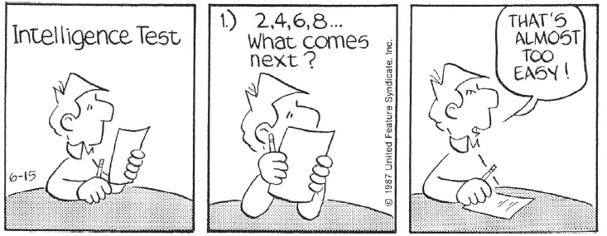
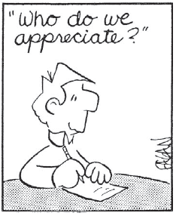
The constant difference is found by subtracting the first term from the next term.
+7
+7

Slide 5
Work together in your groups!

Slide 6
Group Work Time!
Notes:
Do this with the whole class!

Slide 7
-5
-5
-5
-5
-5

Slide 8
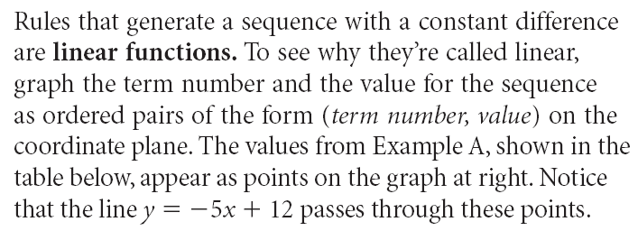
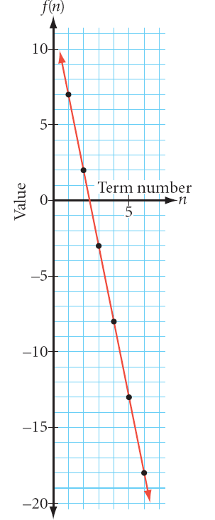
If there is a constant a difference, then we have a linear function.

Slide 10
Practice Time

Slide 11
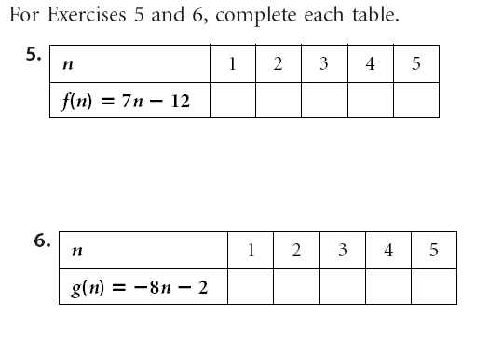

Slide 13
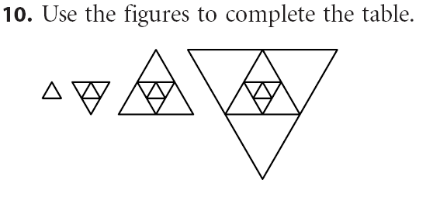

Slide 14
2-3 Mathematical Modeling
Party Handshakes
Each of the 30 people at a party shook hands with everyone else. How many handshakes were there altogether?
We could spend the time and effort to try to act it out and find out. Often times, we don’t have the time, nor the sources to act out a problem. This is when mathematical models come in!
How would you use mathematical modeling (drawing pictures, looking at patterns, analyzing data, creating expressions etc) to solve this problem?
Try it!

Slide 15
Homework Pages 105-106 (5-7, 9, 11-13)

