Slide 1
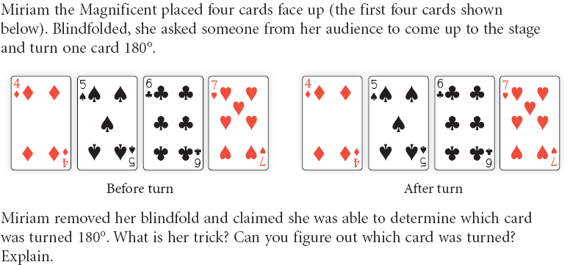
Homework should be on your desk PP. 117-118 (2-6, 8, 10)
Warm-Up
1
2
Notes:
1) 4 of diamonds 2) 22.5 degrees

Slide 2
Lesson 2.5
Angle Relationships
Learning Intentions: Today I will:
Review vocabulary in order to make conjectures about angle relationships.
Define converse.
Success Criteria: I know I’m successful if:
Identify linear and vertical angles.
Give an example of a converse for an “if-then” conjecture.

Slide 3
CONVERSE OF AN If-Then Statement switches the “If” and “then” parts
If today is Tuesday, then tomorrow is Wednesday.
If tomorrow is Wednesday, then today is Tuesday.
The Converse is true! Is this always the case?

Slide 4
For each conditional statement (1) write the converse, (2) decide if the conditional statement is true or false, and (3) decide if the converse is true or false.
If two angles are congruent, then they have the same measure.
If this month is July, then the next month is August.
If m<A = 60, then <A is acute.
If a figure is a square, then it has four congruent sides.
If a quadrilateral is a rectangle, then it has two pairs of parallel sides.

Slide 5
2.5 Angle Relationships
Now that you have had experience with inductive/deductive reasoning, lets use it to start discovering geometric relationships.
We will investigate two cases- linear pairs of angles and vertical angles
We will use those conjectures to solve for different angle measures in diagrams.

Slide 6
Investigation 1: Linear Pair Conjecture
Remember- what is a linear pair of angles- or what does a linear pair of angles look like?
Draw $\overset{⃡}{PQ}$ and place point R between P and Q.
Choose another point S not on the line, and draw $\vec{RS}$.

Slide 7
Investigation 1: Linear Pair Conjecture
3. This is a linear pair of angles. Name the two angles that form the linear pair: ____________
4. What is the sum of the measures of the linear pair of angles?
Linear Pair Conjecture: If two angles form a linear pair, then _________________________.

Slide 8
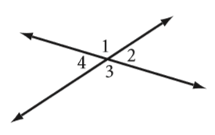
Investigation 2: Vertical Angles Conjecture
Remember- what are vertical angles- or what does a pair of vertical angles look like?
Draw two intersecting lines. Label the angles as shown. Which angles are vertical angles?

Slide 9
Investigation 2: Vertical Angles Conjecture
2. Use your protractor to measure < 1.
3. Use the Linear Pair Conjecture to solve for the measure of < 4.
4. Use the Linear Pair Conjecture to solve for the measure of < 3, and then < 2.

Slide 10
Investigation 2: Vertical Angles Conjecture
5. What can you conclude about the measures of vertical angles?
Vertical Angles Conjecture: If two angles are vertical angles, then ______________________.

Slide 12
Example 2
2
3
1
5
4
a. Are <1 and <2 a linear pair?
Yes
b. Are <4 and <5 a linear pair?
No
c. Are <5 and <3 vertical angles?
No
d. Are <1 and <3 vertical angles?
Yes

Slide 13
Example #4:
If m<6 = 72 then m<7=
108
If m<8 = 80 then m<6 =
80
If m<9 = 110 then m<8=
70
6
123
If m<9 = 123 then m<7=
9
7
If m<7 = 142 then m<8=
38
8
If m<6= 13 then m<9=
167
If m<9= 170 then m<6=
10
If m<8= 26 then m<7=
154

Slide 14
Practice. Use your conjectures!
Solve for the missing angle measurements in each diagram.

Slide 15
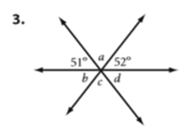
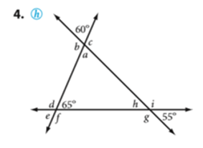
Practice. Use your conjectures!
Solve for the missing angle measurements in each diagram.

Slide 16
Practice. Use your conjectures!
Solve for the missing angle measurements in each diagram.

Slide 17
In Class Practice
You will have the next 10-12 min to finish both sides of the half sheet.
Must turn in before you leave today (at the end of the 10 min)

Slide 18
HOMEWORK
BOOK
PAGES 125-126
#’s 6-11, 13, 15, 16

