Slide 1
Warm Up!
17-18
Get your homework out!

Slide 2
Learning Intentions: Today I will:
Learn and practice the deductive reasoning process.
Learn relationships between inductive and deductive reasoning.
Success Criteria: I know I’m successful if:
1) I can use inductive and deductive reasoning for solving problems.

Slide 3
Practice-
If you have worksheet A, the person next to you with worksheet B has the answers to your problems.
If you have worksheet B, the person next to you with worksheet A has the answers to your problems.
FIRST work on problems 1-4 on your worksheet. Check your answers with the person next to you.
SECOND work on problem number 5 and check your answer with the person next to you.

Slide 5
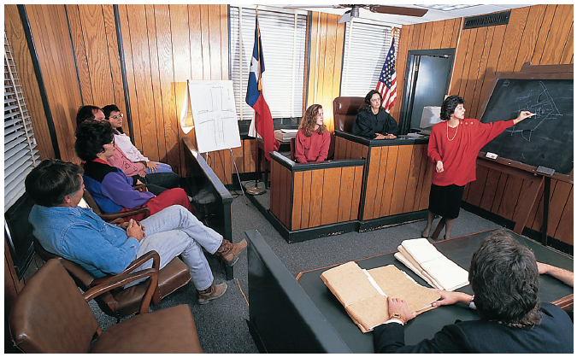
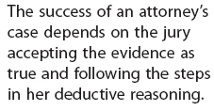

Slide 9
Questions to think about…
What is an obtuse angle?
What is an angle bisector?
What can you say about the two congruent angles when an obtuse angle is bisected?
What must the two angles always be greater than?
What must the two angles always be less than?
Explain why.

Slide 10
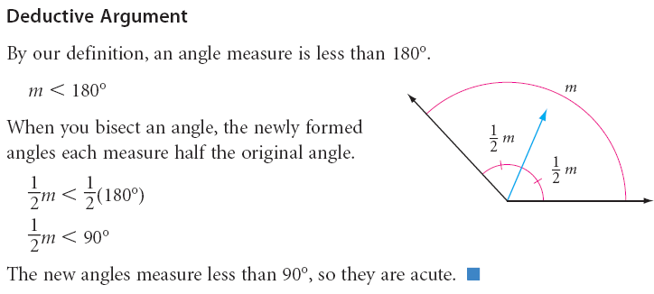
Example of a deductive argument

Slide 11
Work with a partner to complete the investigation

Slide 13
Practice Time!!

Slide 15
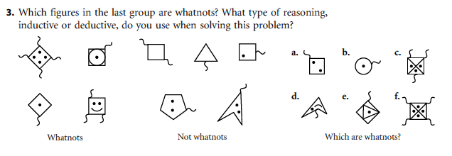

Slide 16
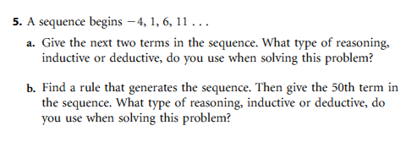

Slide 17
FIN

Slide 18
Homework
PP. 117-118 (2-6, 8, 10)

