Slide 1
DO NOW!
Define:
KITE:
TRAPEZOID:
ISOSCELES TRAPEZOID:

Slide 2
DO NOW!
Define:
KITE: quadrilateral with two pairs of congruent consecutive sides.
TRAPEZOID: quadrilateral with one pair of parallel sides.
ISOSCELES TRAPEZOID: trapezoid where the two NONparallel sides are congruent.

Slide 3
5.3 Kite and Trapezoid Properties
Learning Intentions
Success Criteria
Discover properties of trapezoids and kites
SWBAT use properties of trapezoids and kites to solve for missing angles in practice problems
80% or higher on exit ticket

Slide 4
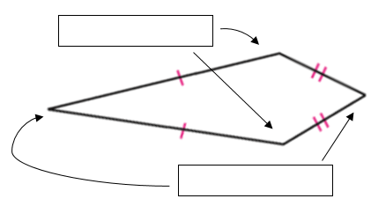
First lets look at kites
Imagine that a kite is constructed from two different isosceles triangles with the same base.
Vertex Angles: the two angles between each pair of congruent sides.
Nonvertex Angles: the two angles NOT between the pair of congruent sides.

Slide 5
Investigation #1 Properties of Kites
Step 1: Trace the kite in the box above onto a piece of tracing paper.
Compare the measures of the pairs of angles by folding one angle onto the opposite angle.
Which angles are congruent? Complete conjecture #1:
1. Kite Angles Conjecture:
The ______________ angles of a kite are congruent.

Slide 6
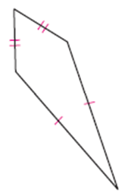
Investigation #1 Properties of Kites
Step TWO: Step 2: Draw the diagonals. How are they related? Complete conjecture #2.
How are the diagonals related? Complete conjecture #2.
2. Kite Diagonals Conjecture:
The diagonals of a kite are _______________.

Slide 7
Investigation #1 Properties of Kites
Step 3: Compare the lengths of the segments on both diagonals. Does either diagonal bisect the other?
Complete conjecture #3
3. Kite Diagonal Bisector
Conjecture:
The diagonal connecting the vertex angles of a kite is the _______________________ of the other diagonal.

Slide 8
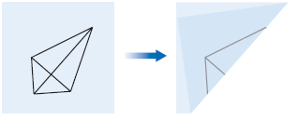
Investigation #1 Properties of Kites
Step FOUR: Fold along both diagonals so that you can compare the measure of the angles. Does any diagonal bisect the angles? Complete conjecture #4:
4. Kite Angle Bisector Conjecture:
The _____________ angles of a kite are bisected by a diagonal.

Slide 9
In summary…
Label the following kite with all the information we know!

Slide 10
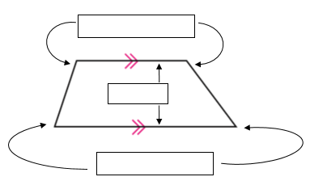
INVESTIGATION #2 PROPERTIES OF TRAPEZOIDS
Bases: the parallel sides are called bases.
Base Angles: the two pairs of angles that share a base as a common side

Slide 11
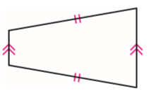
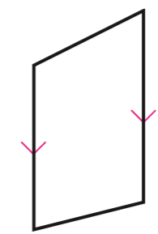
Label these trapezoids
Label the bases and base angles in the two trapezoids below.

Slide 12
INVESTIGATION #2 PROPERTIES OF TRAPEZOIDS
Trace the isosceles trapezoids onto a piece of tracing paper.
Fold your tracing paper to compare the pairs of base angles. What do you notice?
Complete conjecture #5:
5. Isosceles Trapezoid Conjecture:
The base angles of an isosceles trapezoid are
__________________.

Slide 13
INVESTIGATION #2 PROPERTIES OF TRAPEZOIDS
6. Trapezoid Consecutive Angles Conjecture:
The consecutive angles between the bases of a
trapezoid are _____________________.

Slide 14
INVESTIGATION #2 PROPERTIES OF TRAPEZOIDS
Draw both diagonals in the trapezoid. Compare their lengths. What do you notice? Complete conjecture #7:
7. Isosceles Trapezoid Diagonals Conjecture:
The diagonals of an isosceles trapezoid are ________________.

Slide 15
Sum it all up- because it’s a lot
KITES:
Two consecutive congruent sides
Nonvertex angles are congruent
The diagonals are perpendicular.
The diagonal connecting the nonvertex angles is bisected by the other diagonal.
The vertex angles are bisected by their diagonal.
TRAPEZOIDS:
Consecutive angles are supplementary
Base angles are congruent
Diagonals are congruent

Slide 16
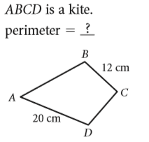
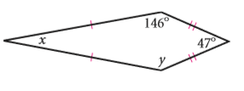
Now practice!
Lets do these first two together…

Slide 17
Exit Ticket
Half sheet
1-5
Only answer A,B,C, D…
You know the drill!

Slide 18
1. Solve for <x
49$°$
73 $°$
107 $°$
58 $°$
x
49$°$
107$°$

Slide 19
2. Solve for the perimeter
34
59
68
43
25
9

Slide 20
3. Solve for <x
75 $°$
105 $°$
115 $°$
95 $°$
x
75$°$

Slide 21
4. Solve for y
64
56
168
186
y-12
2y

Slide 22
5. Solve for x
Given the perimeter=130
13
15
10
12
4x
x+5

