Slide 1
DO NOW!
Have your homework packet out to be checked!!!
Take out a clean sheet of paper
Choose a problem from the packet from #’s 22-24
Copy the problem, the number and the proof down to turn in. (5 min)

Slide 2
Chapter 5- discovering and proving polygon properties
In Chapter 4, we learned different properties about triangles and how to prove them- for example:
The angles in a triangle sum to $180°$
How to identify base angles in an isosceles triangle
How to solve for angle measurements in all types of triangles
In Chapter 5 we will discover and prove properties of polygons, including:
Studying properties of convex polygons
Discovering relationships between angles, sides, and diagonals of triangles

Slide 3
5.1 Polygon sum conjecture
Learning Intentions
Students will develop a formula for determining the sum of the interior angles in a polygon, and use that formula to solve for missing angle measurements.
Success Criteria:
Students will achieve 80% or higher on exit ticket and will be able to correctly use the polygon sum formula.

Slide 4
Review of polygons
Polygon: a closed figure in a plane, formed by connecting line segments endpoint to endpoint, with each segment intersecting exactly two others.
The name of a polygon depends on the number of sides it has. Below is a family tree of some of the regular polygons. Lets try to name some.

Slide 5
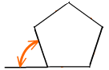
The sum of the measures of interior angles of a polygon depends on the number of sides it has.
Exterior Angle
Interior Angle
Here are the Questions you will be Investigating Today!
How can the sum of the interior angles of a polygon be found?
2. How can the measure of one interior angle of a regular polygon be found?
Now, let’s Explore!

Slide 6
Investigation #1 is there a polygon sum formula?
Step 1: Divide the quadrilateral above into two triangles. Using our knowledge of the angles in a triangle, what would the angles in a quadrilateral sum to?
Step 2: Fill in Table A in the appropriate space:

Slide 7
Investigation #1 is there a polygon sum formula?
Step 3: Repeat steps one and two for the pentagon and the hexagon.
Step 4: Fill in the missing information in the table by finding the pattern!

Slide 8
Investigation #1 is there a polygon sum formula?
Step 5: Complete conjectures 1 and 2
1. Quadrilateral Sum Conjecture:
The sum of the measures of the four interior angles of any quadrilateral is _______ .
2. Pentagon Sum Conjecture:
The sum of the measures of the five interior angles of any pentagon is _______ .

Slide 9
Investigation #1 is there a polygon sum formula?
Step 6: Use the same polygons- quadrilateral, pentagon, and hexagon- to fill in Table B below.

Slide 10
Investigation #1 is there a polygon sum formula?
Step 7: Use information from Table A and Table B to develop a formula for the sum of the measures of any polygon, and then complete conjecture 3.
…
360$°$
540$°$
720$°$
900$°$
1080$°$
2
3
4
5
6
n-2
Polygon Sum Conjecture:
The sum of the measures of the n interior angles of an n-gon is
________________

Slide 11
Practice!
Use the Polygon Sum Conjecture to complete the table.

Slide 12
Practice!
2. What is the measure of each angle in an equiangular polygon? Complete the following table.
Remember- equiangular is defined in your Do Now!

Slide 13
What is the sum of the angles in a 22-gon?

Slide 14
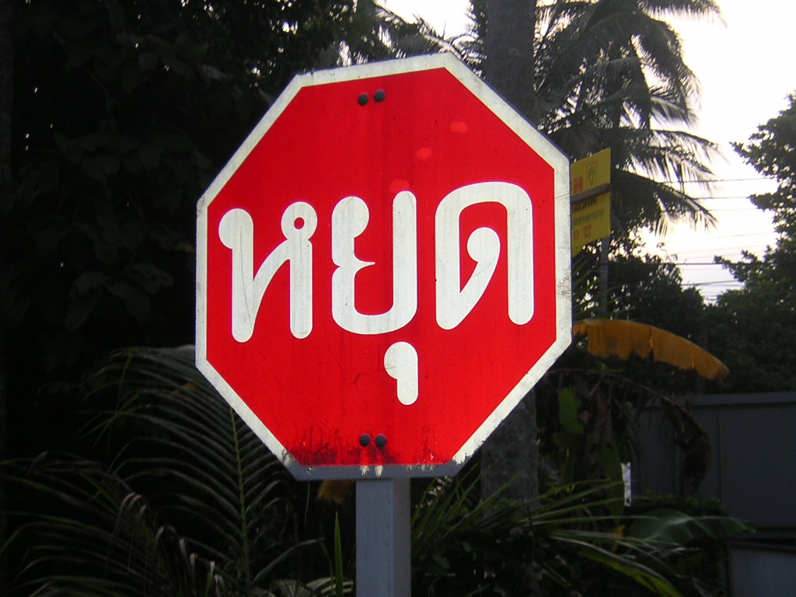
What is the measure of this angle?
You want a hint?

Slide 15
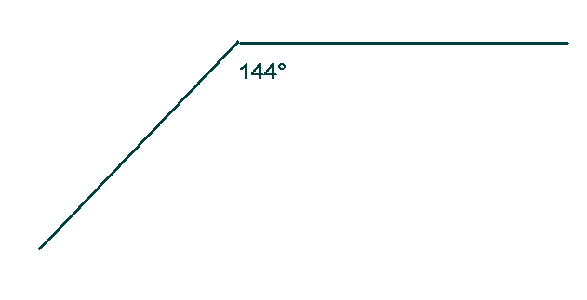
How many sides does the polygon have?
This angle is from a regular polygon

Slide 16
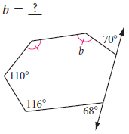
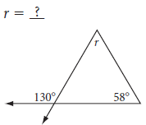
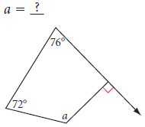
PRACTICE!
1. 3.
2.

Slide 19
EXIT TICKET!
This is to taken independently and silently!

Slide 20
1.
What is the sum of the interior angles of a heptagon? (7-sided polygon)
1,080 $°$
B. 720 $°$
C. 900 $°$
D. 1,260 $°$

Slide 21
2.
What is the sum of the interior angles of a dodecagon? (12-sided polygon)
1,800 $°$
B. 2,160 $°$
C. 900 $°$
D. 2,610 $°$

Slide 22
3.
What is the measure of ONE angle in an equiangular pentagon?
A. 540 $°$
B. 108 $°$
C. 180 $°$
D. 90 $°$

Slide 23

4.
Solve for the m< k.
98$°$
B. 75$°$
C. 442$°$
D. 82$°$

Slide 24
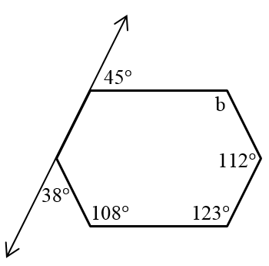
5.
Solve for the m< b.
108$°$
B. 123$°$
C. 142$°$
D. 100$°$

