Slide 1
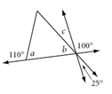
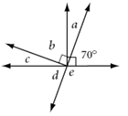
Do Now: Review! Solve for the missing angle measures.

Slide 2
Chapter 4: Discovering and proving triangle properties
Objectives: In this chapter we will:
Discover relationships between the sides and angles of triangles
Learn about the conditions that guarantee that two triangles are congruent
Show that pairs of angles or pairs of sides are congruent
Discover inequalities among sides and angles in triangles

Slide 3
4.1 triangle sum conjecture, 4.2 Isosceles triangles
Learning Intentions:
Students will understand the essential vocabulary of an isosceles triangle, and make important conclusions by solving complex diagrams using the triangle sum conjecture.
Success Criteria:
Students can solve at least one advanced level practice problem.
Students can win on the tic-tac-toe board.

Slide 4
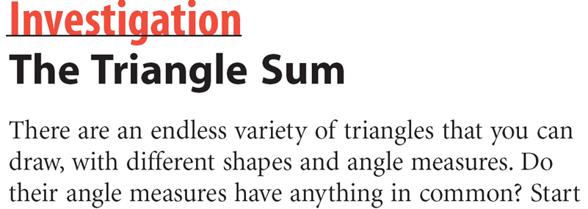
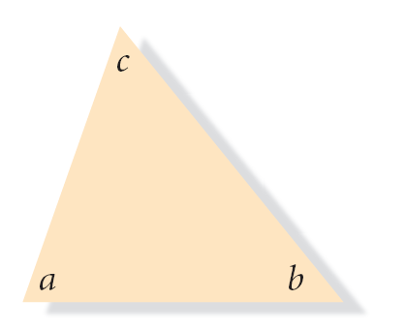
by drawing a triangle on a separate sheet of paper.
Write the letters a, b, and c in the interiors of the three angles and carefully cut out the triangle.

Slide 5
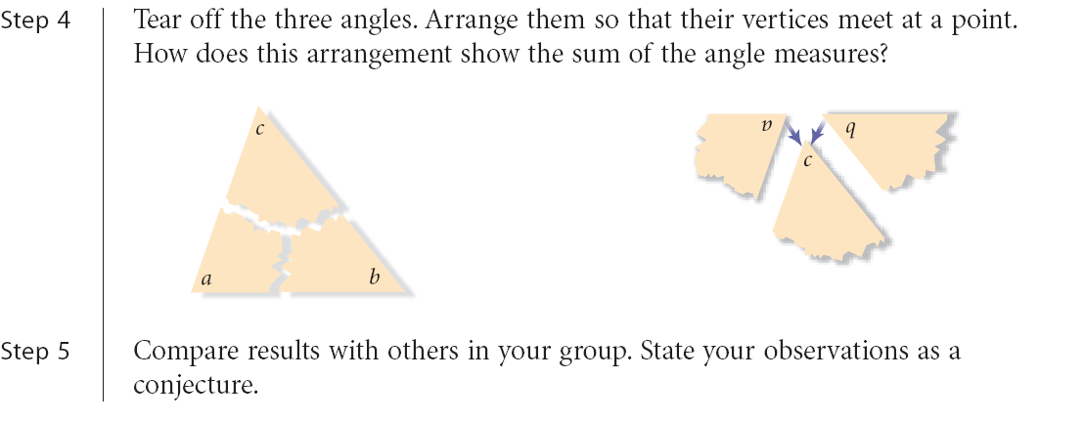

Slide 6
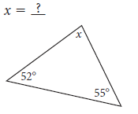
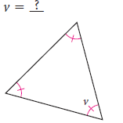
Now lets practice – Level one *basic
Notes:
X=73
V=60

Slide 7
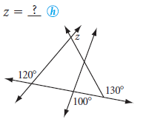
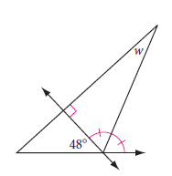
Now lets practice – Level two*proficient
Notes:
Z=110
W=24

Slide 8
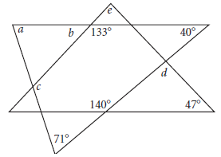
Now lets practice – Level three*advanced
Notes:
A=69
B=47
C=116
D=93
E=86

Slide 9
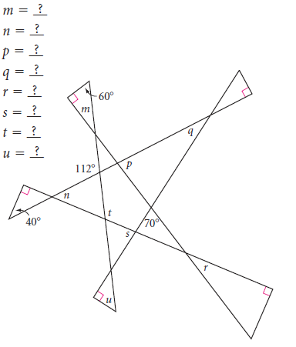
Now lets practice – Level three*advanced

Slide 10
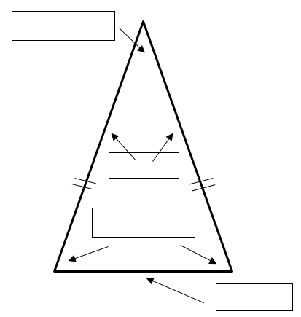
4.2 Isosceles triangles
Label these two triangles

Slide 11
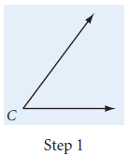
Investigation #1 Base angles in an isosceles triangle

Slide 12
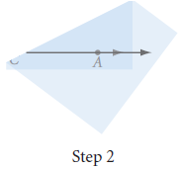
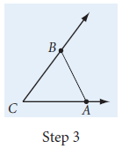

Slide 13
Step 4: Fold the tracing paper to compare the measures of the base angles. What do you notice?
Isosceles Triangle Conjecture: If a triangle is isosceles, then
________________________________, and conversely if a triangle has two
congruent angles, then __________________________.

Slide 14
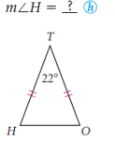
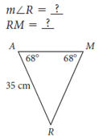
Now lets practice – Level one *basic

Slide 15
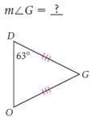
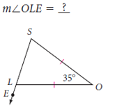
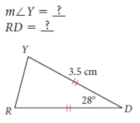
Now lets practice – Level two*proficient

Slide 16
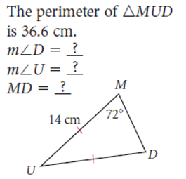
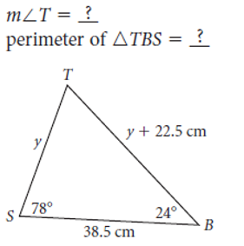
Now lets practice – Level three*advanced

