Slide 1
Lesson 2.6 Special Angles on Parallel Lines
Learning Intentions
WALT identify the transversal and the different types of angles formed when a transversal cuts two parallel lines.
Success Criteria
Students use proper vocab. When identifying angles and use conjectures to solve for the measures of different angles.

Slide 2
Goal # 1: Identify the Transversal
The Transversal is the line that intersects two other lines in the plane.
In this lesson, a transversal will usually intersect two parallel lines.
When a transversal intersects two parallel lines, three different types of angle pairs are formed.
Transversal
>>
>>

Slide 3
Identify the transversal…
a
c
b

Slide 4
Goal # 2: Identify Angles Formed by the Transversal
The Transversal is the line that intersects two other lines in the plane.
When a transversal intersects two parallel lines, three different types of angle pairs are formed.
Corresponding Angles
Alternate Interior Angles
Alternate Exterior Angles
Transversal
Exterior
>>
1
2
Interior
3
4
5
6
>>
Interior
7
8
Exterior

Slide 5
Goal # 2: Identify Angles Formed by the Transversal
Corresponding Angles: Corresponding angles have corresponding, or matching, positions.
For example <1 corresponds with <5. They are both in the top right position.
Find three other pairs:
Transversal
Exterior
>>
1
2
Interior
3
4
5
6
>>
Interior
7
8
Exterior

Slide 6
Goal # 2: Identify Angles Formed by the Transversal
Alternate Interior Angles: Angles that are on the interior, or between the two parallel lines, and are on opposite sides of the transversal.
One pair of alternate interior angles is <3 and <6.
Find another pair of alternate interior angles:
Transversal
Exterior
>>
1
2
Interior
3
4
5
6
>>
Interior
7
8
Exterior

Slide 7
Goal # 2: Identify Angles Formed by the Transversal
Alternate Exterior Angles: Angles that are in the exterior, or on the outside of the parallel lines, and are on opposite sides of the exterior.
One pair of alternate exterior angles is <1 and <8.
Find another pair of alternate exterior angles.
Transversal
Exterior
>>
1
2
Interior
3
4
5
6
>>
Interior
7
8
Exterior

Slide 8
Now Practice…
Complete worksheet Side A by classifying each pair on angles as:
Corresponding Angles
Alternate Interior Angles
Alternate Exterior Angles

Slide 9
ANSWERS
Corresponding Angles
Alternate Interior Angles
Alternate Exterior Angles
Corresponding Angles
Alternate Exterior Angles
Corresponding Angles

Slide 10
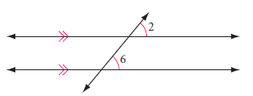
Lets use some reasoning…
Conjecture 1: Identify the type of angles below
If two parallel lines are cut by a transversal, then
_____________________________________________.

Slide 11
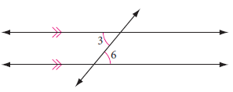
Lets use some reasoning…
Conjecture 2: Identify the type of angles below
If two parallel lines are cut by a transversal, then
_____________________________________________.

Slide 12
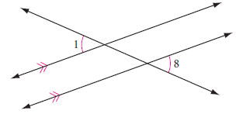
Lets use some reasoning…
Conjecture 3: Identify the type of angles below
If two parallel lines are cut by a transversal, then
_____________________________________________.

Slide 13
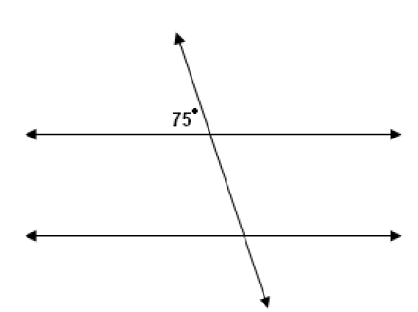
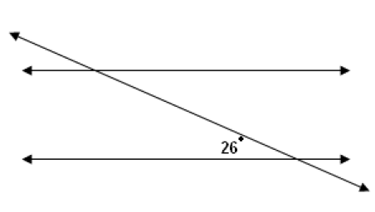
Now practice.
FIRST practice solving for one or two angles on a simple diagram on SIDE B.

Slide 14
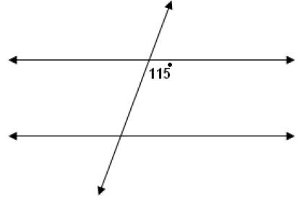
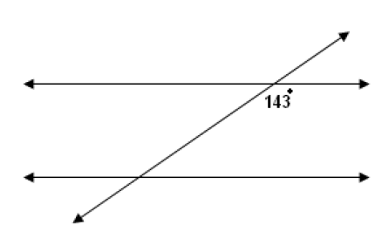
Now practice.
FIRST practice solving for one or two angles on a simple diagram on SIDE B.

