Slide 1
1.7 Circles

Slide 2
1.7 Circles
Learning Intentions
Success Criteria
Students will evaluate and critique examples and counterexamples to understand new circle and parts of circle vocabulary words.
I know I am successful when I can define the different parts of a circle and can complete at least 80% of the practice.

Slide 3
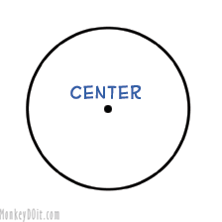
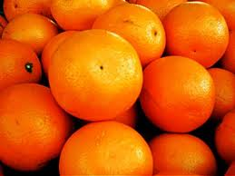
Center
The point in the middle of the circle.
The point that is the same distance from all other points on the circle
We name a circle by its center

Slide 4
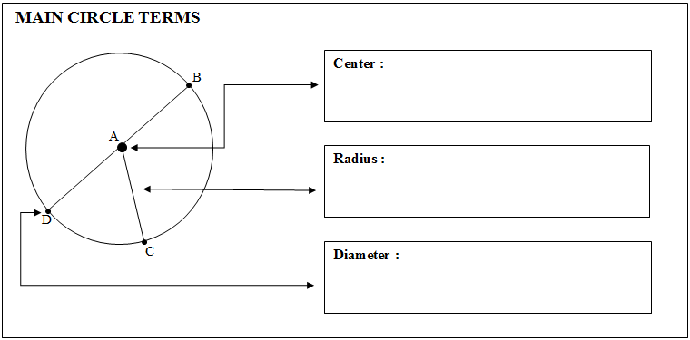
Fill in and define these as we go
The point in the middle of the circle,
we name a circle by its center. This is circle A.

Slide 5
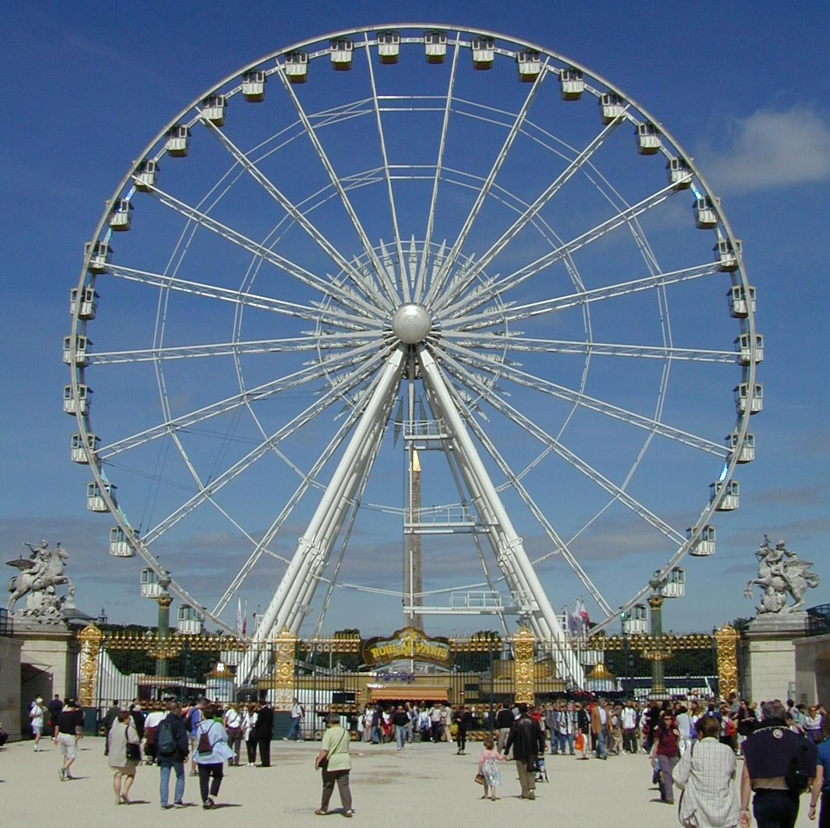
Radius
The radius of a circle is a segment from the center to a point on the edge of the circle.

Slide 6
Fill in and define these as we go
The point in the middle of the circle,
we name a circle by its center. This is circle A.
The radius of a circle is a segment from the center to a point on the edge of the circle. This is radius $\overline{AC}.$

Slide 7
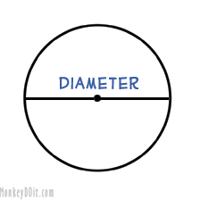
Diameter
A diameter of a circle is a chord that passes through the center of the circle.
A diameter is the longest chord.
A diameter cuts a circle in half.

Slide 8
Fill in and define these as we go
The point in the middle of the circle,
we name a circle by its center. This is circle A.
The radius of a circle is a segment from the center to a point on the edge of the circle. This is radius $\overline{AC}.$
A diameter is a segment that cuts the circle in half and passes through the center. This is diameter $\overline{DB}.$

Slide 9
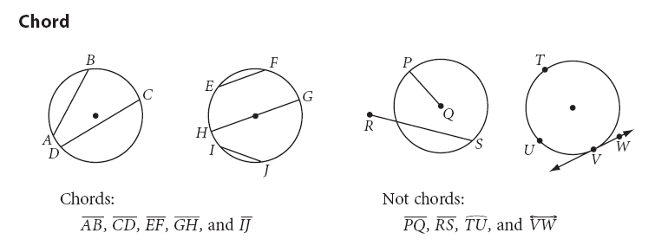
Chord
A chord is a line segment whose endpoints are on the circle.

Slide 10
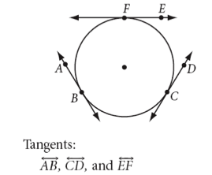
Tangent & Point of Tangency
A tangent is a line that intersects a circle at one point.
The one intersection is called the Point of Tangency

Slide 11
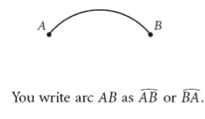
Arcs
An arc of a circle is two points on the circle and the continuous part between them.

Slide 12
What kinds of arcs are there?
You classify arcs into three types:
Minor Arcs
Major Arcs
Semicircles

Slide 13
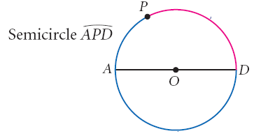
Arcs Continued…
A SEMICIRCLE is an arc whose endpoints are the endpoints of a diameter (or half the circle!)
A MINOR ARC is an arc that is smaller than a semicircle.
A MAJOR ARC is an arc that is bigger than a semicircle.

Slide 14
Naming Arcs-1
What is different about how minor arcs are named, and the way semicircles and major arcs are named?
Name semicircles and major arcs with three letters!
Name minor arcs with only two.

Slide 15
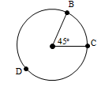
Arc Measure
Arcs have a degree measure just like angles do. A full circle has an arc measure of ________. A semicircle has an arc measure of _________.
Central Angle: The angle with the vertex at the center of the circle. The measure of the __________ is the same as the measure of the central angle.
How can we solve for the major arc formed by a central angle?
$\hat{BC}$, a minor arc, $m\hat{BC}$ =
$\hat{BDC}$, a major arc, $m\hat{BDC}$ =

Slide 16
Concentric Circles
Concentric Circles are circles that are coplanar that share the same center.
The arc measures will be the same but the arc lengths will be different.
S
M
8cm
5cm
35°
T
P
O
mArc MP = 35°
mArc ST = 35°
m‹MOP = 35°

Slide 17
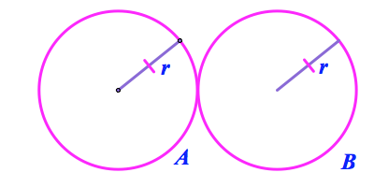
Congruent Circles
What will two or more congruent circles look like?
* Circles that have the same radius are congruent circles.

Slide 18
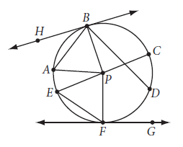
PRACTICE

