Slide 1
DO NOW!
What is an acute angle? What is a right angle?
What is an obtuse angle? What does equilateral mean?

Slide 2
1.5 Triangles
Learning Intentions: Students will understand essential vocabulary of special triangles and evaluate and critique definitions of these terms.
Success Criteria: I know I am successful when I can define a triangle by its sides and angles AND complete 85% of my practice problems correctly

Slide 3
We classify triangles by both its sides AND angles
Use your experience with writing definitions and using counterexamples to define the following:
Right Triangles
Acute Triangles
Obtuse Triangles
Scalene Triangles
Isosceles Triangles
Equilateral Triangles

Slide 4
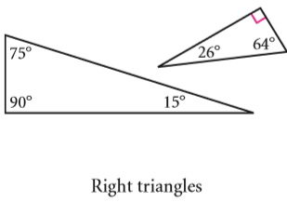
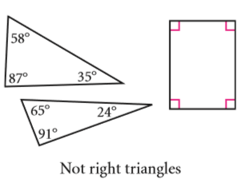
RIGHT TRIANGLES
RIGHT TRIANGLE: a triangle that has one right angle.

Slide 5
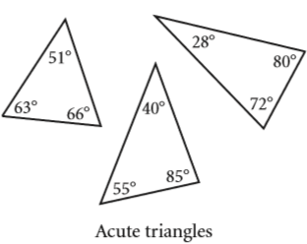
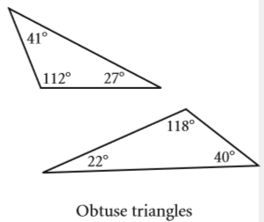
ACUTE OBTUSE TRIANGLE TRIANGLE
ACUTE TRIANGLE: a triangle with three acute angles
OBTUSE TRIANGLE: a triangle with one obtuse angle.

Slide 6
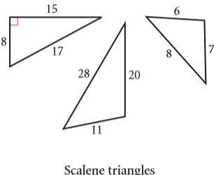
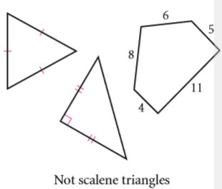
SCALENE TRIANGLE
SCALENE TRIANGLE: a triangle with no sides congruent.

Slide 7
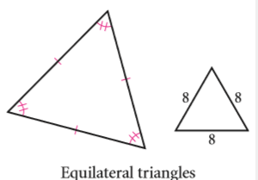
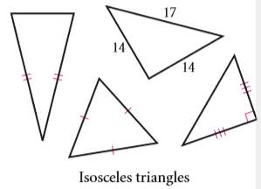
EQUILATERAL ISOSCELES TRIANGLE TRIANGLE
EQUILATERAL TRIANGLE: a triangle with all sides congruent
ISOSCELES TRIANGLE: a triangle with two congruent sides

Slide 8
NOTE!!
Because Right, Obtuse, and Acute classify a triangle by its ANGLES, and Scalene, Equilateral, and Isosceles classify a triangle by its SIDES, a triangle can be both Right AND Scalene- or Acute AND Isosceles-or any other combination of the names of sides and angles.

Slide 9
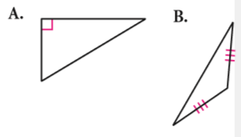
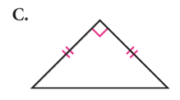
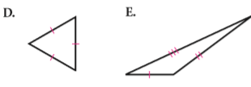
PRACTICE: Match the terms on the left with its figure on the right
.
Equilateral Triangle
2. Scalene Right Triangle
3. Isosceles Right Triangle
4. Isosceles Obtuse Triangle

Slide 10
1.6 Quadrilaterals
Learning Intentions: Students will learn to understand essential vocabulary and compare and contrast different types of special quadrilaterals.
Success Criteria: I will know I am successful when I can complete 85% of my in class practice problems, and can identify the difference between all special quadrilaterals.

Slide 11
B2, B4, B5
Use your experience with writing definitions and using counterexamples to define the following:
Trapezoids
Kites
Parallelograms
Rhombuses
Rectangles
Squares

Slide 12
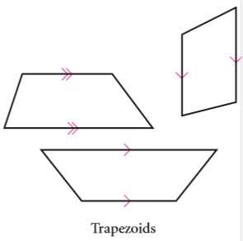
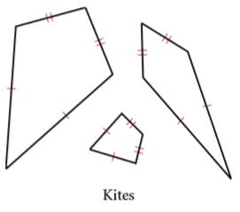
TRAPEZOIDS KITES
TRAPEZOID: a quadrilateral with one pair of parallel sides
KITE: a quadrilateral with two pairs of consecutive congruent sides

Slide 13
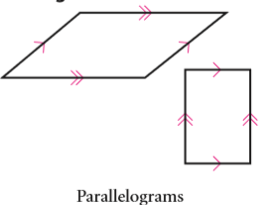
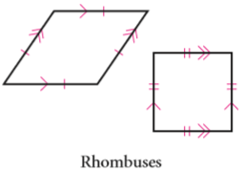
PARALLELOGRAM RHOMBUS
PARALLELOGRAM: a quadrilateral with two pairs of parallel sides
RHOMBUS: a quadrilateral with two pairs of parallel sides and all sides congruent.
OR an equilateral parallelogram

Slide 14
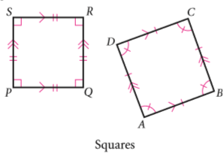
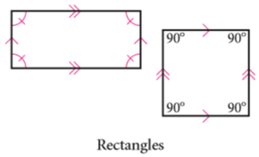
RECTANGLE SQUARE
RECTANGLE: a quadrilateral with two pairs of parallel sides and four congruent angles.
OR an equiangular parallelogram
SQUARE: a quadrilateral with two pairs of parallel sides and all sides and angles congruent.
OR a regular parallelogram

Slide 15
NOTE!!
You should always pay attention to the congruent markings on a quadrilateral NOT the specific shape
Example: Based off of the marks, give the BEST definition for the following quadrilaterals:

Slide 16
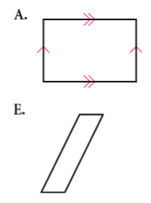
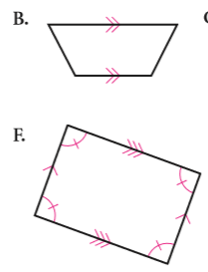
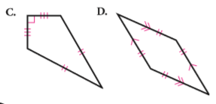
PRACTICE Match the terms on the left with its figure on the right.
Trapezoid
Rhombus
Rectangle
Kite
Parallelogram

