Slide 1
Warm-Up
What is the difference between Supplementary Angles and Angles on a Line?
Have your homework on your desk to be checked off!

Slide 2
Learning Intentions: Today I will:
Learn properties of polygons.
Classify polygons.
Success Criteria: I know I’m successful if:
I can classify polygons

Slide 3
Answers to Homework
(click above)

Slide 5
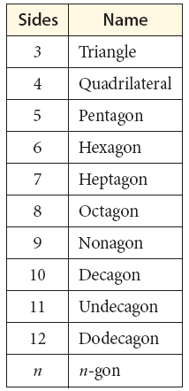

Slide 6
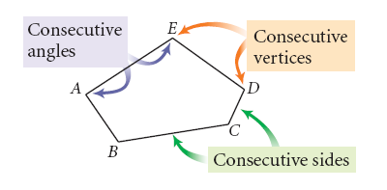
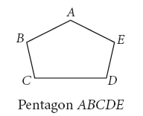
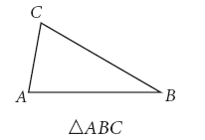

Slide 7
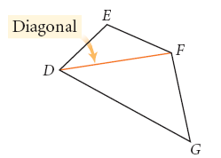

Slide 8
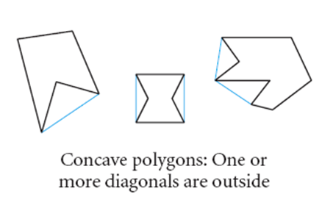
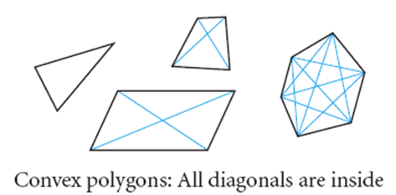

Slide 9
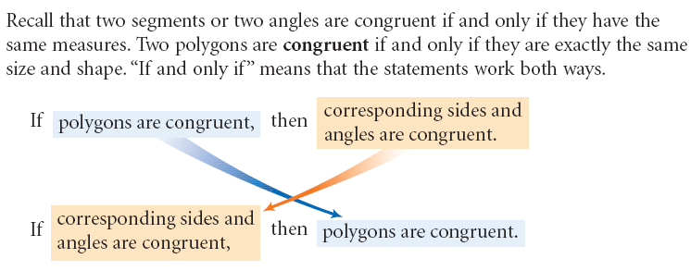

Slide 10
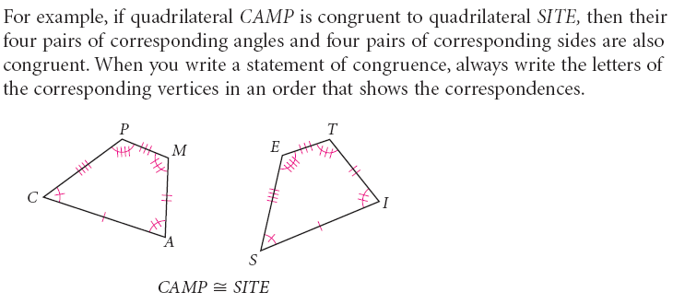

Slide 11
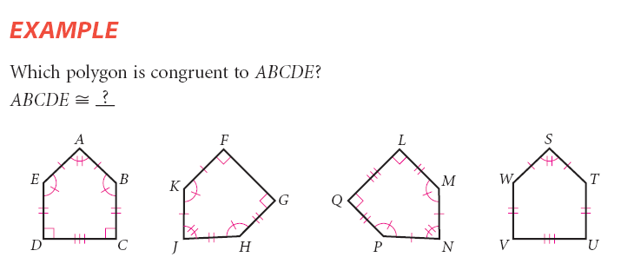

Slide 13
Turn to page 56 in your book.

Slide 14
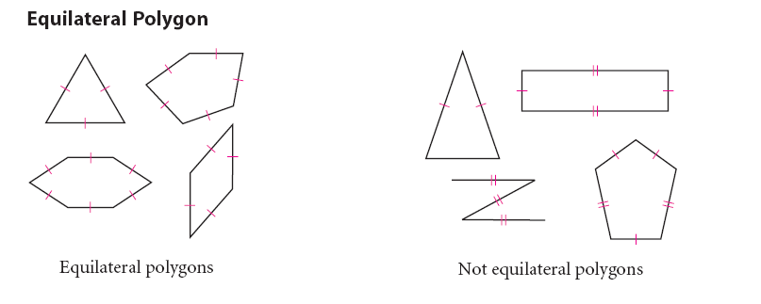

Slide 16
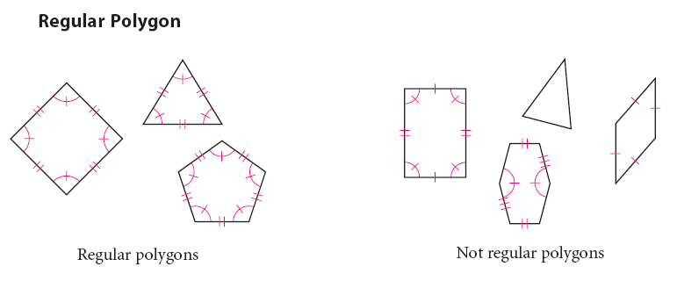

Slide 17
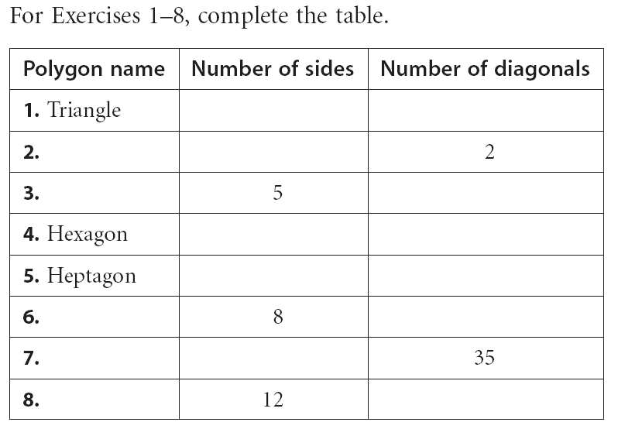
Practice in Class time
I’d copy this In my notebook
3
0
Quadrilateral
4
Pentagon
5
6
9
7
14
Octagon
20
Decagon
10
Dodecagon
54

Slide 18
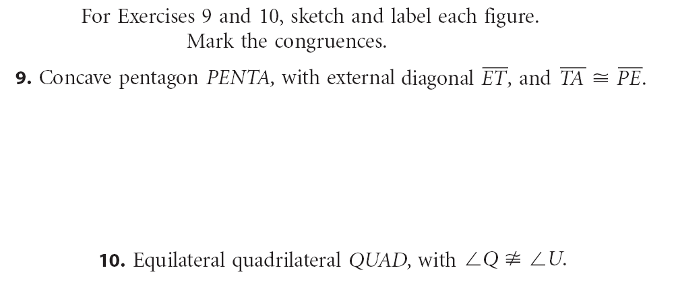

Slide 20
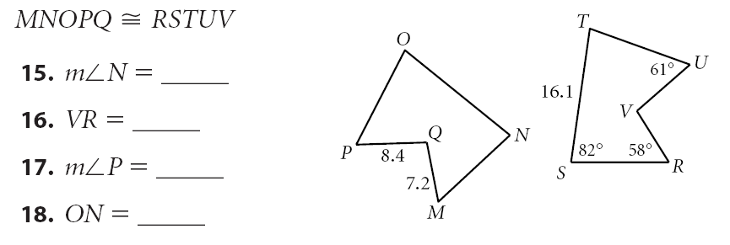

Slide 21
Quiz Next Class!
Homework Practice
PP 56-58
(1-8 ←pick 5, 11-17,21-23)

