Slide 1
Warm-Up
1. Draw AC bisecting BD at F
2. What is F considered in the diagram?
3. Draw GH = 2.5 with H being the midpoint of GJ

Slide 2
Learning Intentions: Today I will:
Learn how to measure and write geometric notation for angles.
Practice writing definitions and use counterexamples to refine them.
Define special angle relationships
Success Criteria: I know I’m successful if:
I can define and measure angles
I can write detailed definitions
Complete 90% of my homework assignment correctly.

Slide 3
Angle: formed by 2 rays that share a common endpoint.
Vertex: where both rays meet to form a single point.
Sides: the 2 rays that create the angle.
This is the symbol for angle

Slide 4
Naming an Angle
B
You name an angle by it’s vertex
This would be A
D
1
A
2
Now can we call it LA?
C
When there is more than one angle at a vertex
Use 3 letters
The middle letter must be the vertex.
The other 2 letters are points on either side (ray)
LBAD
Sometimes an angle may be labeled by a number. L1 and L2

Slide 5
The Measure of an Angle is the smallest amount of rotation about the vertex from one ray to another, measured in degrees. (0-180°).

Slide 6
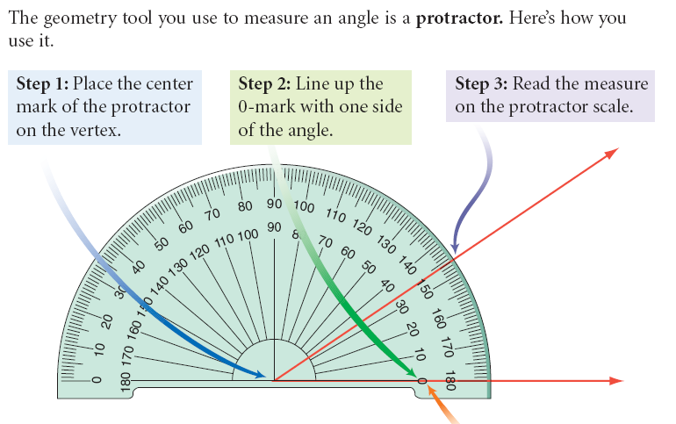
This is in your book on Page 39!

Slide 7
PRACTICE!
Turn your book to page 40.
Practice measuring the three angles displayed.

Slide 8
How can we make a good definition?

Slide 10
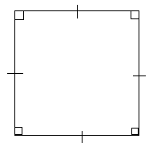

Slide 11
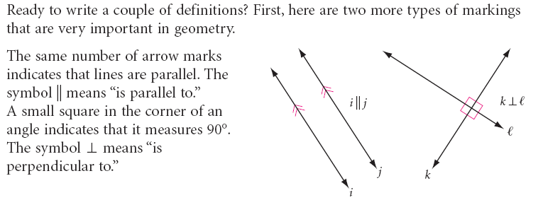

Slide 13
Book p.49

Slide 14
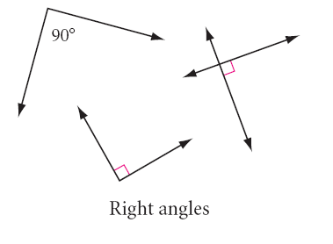
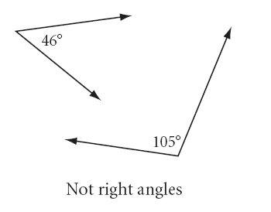
A Right Angle is ______________________________________

Slide 15
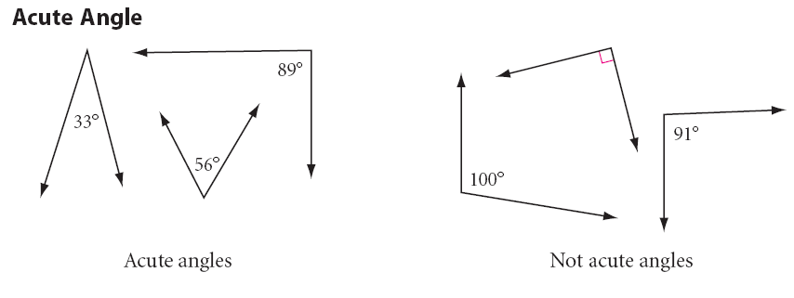

Slide 16
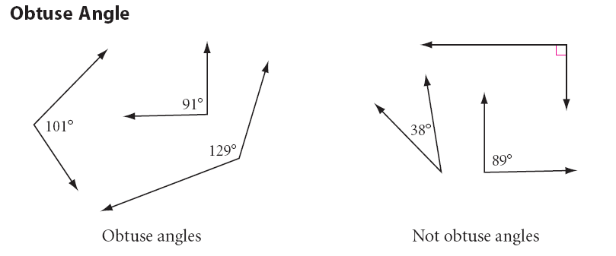

Slide 17
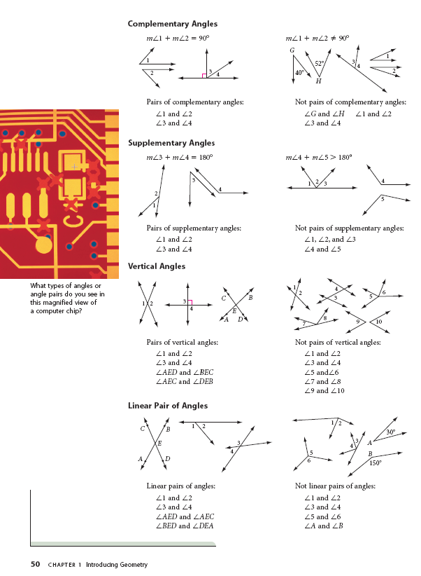
Open your books to page 50. Finish writing the definitions for the words on this page.

Slide 18
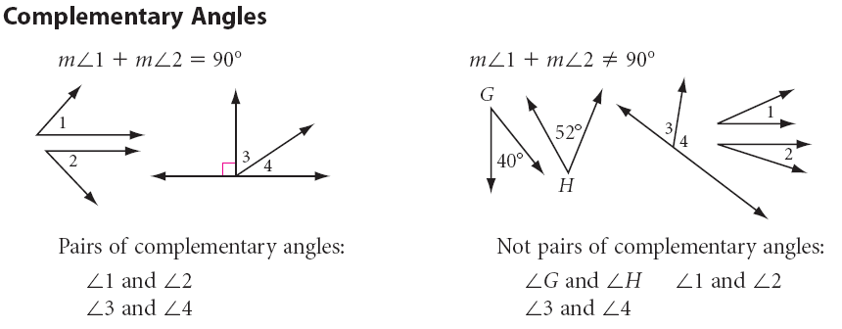

Slide 19
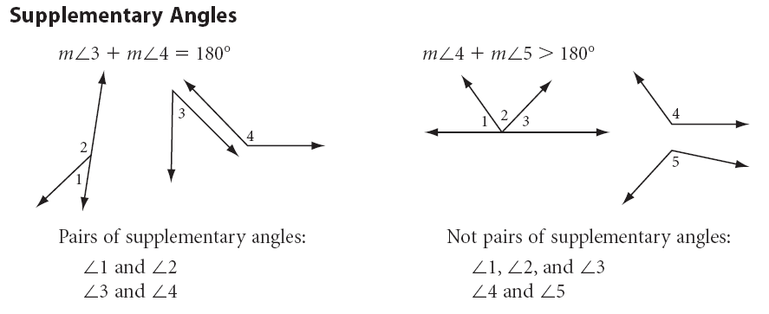

Slide 20
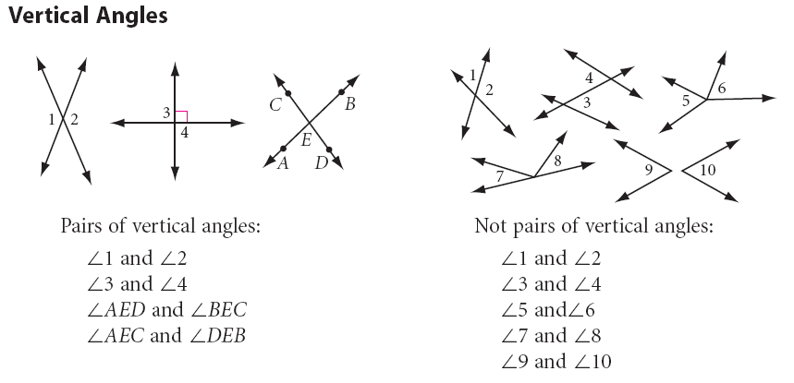

Slide 21
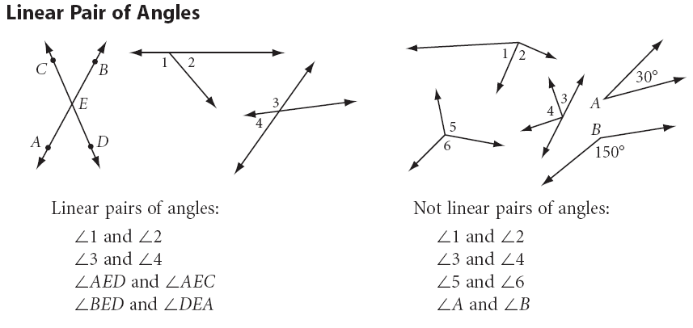

Slide 22
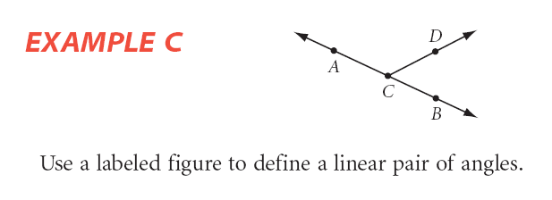

Slide 23
Remember if you are not understanding this, you should use resources to help you.
Reaganperez.weebly.com
Khanacademy.com
Brightstorm.com
Youtube.com

Slide 24
Practice in class time

Slide 25
Homework Practice
PP. 51-52
(1-8, 12-24)

