Slide 1
Welcome Back!!!
Find your seats – attendance
School handouts
Syllabus and expectations
Homework is not an option, it is mandatory.
Draw this activity!!!

Slide 2
Class discipline policy
Class Rules adopted from PBIS:
Be Safe
Be Respectful
Be Responsible
These 3 simple rules are used school wide as part of our PBIS program and cover the expectations I have for well behave and well prepared students in my class.
Preventive Discipline:
Clear rules and procedures given on first day
Rules and procedures reviewed on second day
Zero noise signal (peace)
Reactive Discipline:
Warning
One-on-one conversation
Detention
Phone call home
Referral to administration

Slide 3
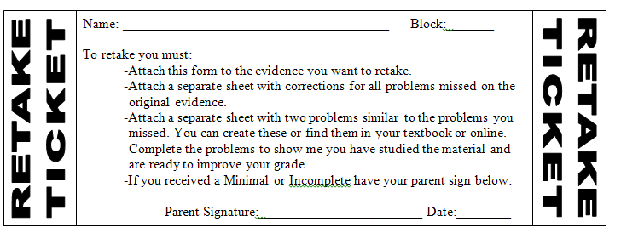
Retake policy
Students can retake or redo any graded work, unless otherwise stated on the assignment, to attempt to improve their grade.
Students wishing to receive an Advanced score must retake the assessment within 2 weeks of receiving their original grade.
Any unexcused late work cannot be redone!
To ensure that students have prepared themselves for the retake they must bring in a completed retake ticket. Student can get a retake ticket from me at any time.

Slide 4
Learning Intentions: Today I will:
Learn the terminology and notation of points, segments, lines, rays, planes, angles, collinear and coplanar points.
Learn about congruence and how to mark that on diagrams.
Practice cooperating behavior.
Success Criteria: I know I’m successful if:
I can define the above terms.
I can complete 80% of my homework assignment correctly.
Contract due!

Slide 5
Understanding vocabulary is extremely important in all disciplines, especially mathematics. To define mathematical things you need to learn the language.
Yes, this IS another language class. The language of science.
To see the importance of knowing the language, each group must work on the following activity.
One person describes the picture the best they can without showing the group
The others will draw the picture the person describes the best they can without looking at the picture
After the picture has been described and drawn, you may look at. Does your drawing look the same? Could you have described this better if you knew the vocabulary to describe the picture?
Notes:
Make copies of pic 1 and pic 2---you may want to do pic 1 with them and pic 2 as groups.

Slide 6
Discussion
Define what makes a good definition when defining a word. Write down all the details you can think of for defining a word.
Example try defining these words: Poodle, Centimeter, Milwaukee, etc.

Slide 7
The three building blocks of Geometry.
(Sometimes known as the undefined terms)
Point
Line
Plane
There are not any definitions, because they are undefined.
Kind of like defining what blue is. We know what it is , we can give examples , but what is it?
Blue does have a definition. The color between green and violet in the visible spectrum, an effect of light with a wavelength between 450 and 500 nm.

Slide 8
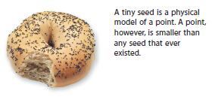
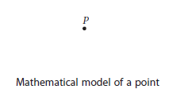
Point – basic building block of Geometry
1. has no size
2. only location
3. to display use a dot
4. to name use a capital letter
Example:

Slide 9
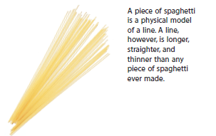
Line
Is straight
Continuous, made of infinitely many points
Infinite length (never ends)
No thickness
Continuous in two directions
Example:
B
C
When you name a line you use ONLY TWO LETTERS!
BC
or
CB
m
Ex.
Note: sometimes a line will be named with a small script letter

Slide 10
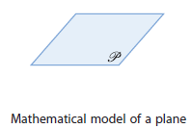
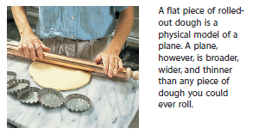
Plane
It has length and width
No thickness
It’s a flat surface that extends infinitely along
its width and length.
4. Represented by a four-sided plane.
5. Named with a script capital letter. P

Slide 11
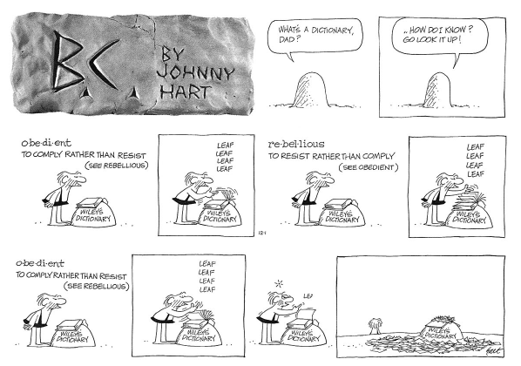
You may recognize each of the previous terms, but they are very difficult to define. Sort of like the cave guy in the comic strip below.

Slide 12
A definition is a statement that clarifies or explains the meaning of a word or a phrase. However it is impossible to define point, line and plane without using words or phrases that themselves need definition.
So these terms remain undefined. Yet, they are the basis of Geometry.
Collinear -
On the same line
D E F
G
Points D, E, and F are collinear
Point G is not collinear with Points D, E, and F.

Slide 13
Coplanar-
On the same plane
Points G, H and I
are coplanar
G
I
H
Line segment -
Consists of two points called endpoints of the
segment and all the points between them that
are collinear with the two points.
Endpoints are
A and B
A B
Line segment
Named
AB

Slide 14
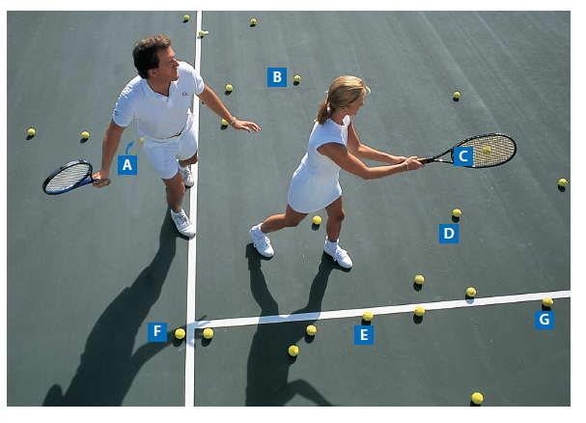
Do this in your groups!!!
Ball A is in the pocket of the man.
Ball C is on the woman’s racquet.
All other balls are on the tennis court.
Name 3 balls that are collinear.
Name 3 balls that are coplanar, but not collinear.
Name 4 balls that are not coplanar.

Slide 15
Congruent -
Same Size and Shape.
You use equal to
with numbers
AD =____
D
3.2cm
3.2 cm
3.2 cm
A C
You use “is congruent to” with figures.
CD
AD
When you are talking about a distance you use an equal sign
When you are talking about the shape you use a congruent symbol

Slide 16
When drawing figures, you show congruent segments by making identical marks.
These single marks mean these two segments are
congruent to each other.
B
L
O
A
C
M
N
LM
ON
and
LO
MN

Slide 17
Midpoint – the point on the segment that is the same
distance from both endpoints.
Bisect – divides the segment into two equal/congruent
segments
Coordinate Midpoint Property
If (x₁, y₁) and (x₂, y₂) are the coordinates of the endpoints then the coordinates of the midpoint are
Example Segment AB has endpoints (-8, 5) and (3, -6).
Find the midpoint of segment AB.

Slide 18
Ray – has one endpoint and one other point on the
same side of the endpoint.
written
AB
A B
Note
BA
Is not the same as
AB
So watch how you
label the ray.
(You don’t need the dot)
It’s a shame about Ray.

Slide 19
What happens if you get scared half to death twice?

Slide 20
Can you draw?
Draw point T on segment PU

Slide 21
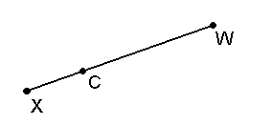
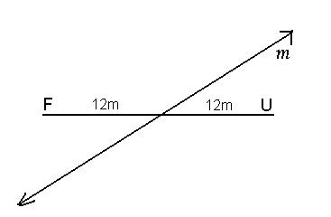
What is this a picture of?

